Slide 1
Shoreline Assessment and Evaluation
CGPRT(W) : Ensuring Clean Seas and Coasts in Western Region ……

Slide 2
Objective
To understand the operational aspects of shoreline assessment and evaluation.
CGPRT(W) : Ensuring Clean Seas and Coasts in Western Region ……

Slide 3
Shoreline Assessment
In order to make decisions on shoreline treatment and response operations, management requires real-time data on oiling conditions. This is the purpose of shoreline assessment and of a SCAT (Shoreline Clean-up Assessment Technique) team.
In higher risk locations, baseline information for SCAT may be acquired during contingency planning.
CGPRT(W) : Ensuring Clean Seas and Coasts in Western Region ……

Slide 4
Shoreline Assessment Principles
Identify oiled and non-oiled areas
Identify location, amount and character of oil
Evaluate operational and logistical factors
Establish shoreline treatment priorities
Establish treatment standards
Propose treatment methods
Consider how proposed operations can prevent any additional damage
CGPRT(W) : Ensuring Clean Seas and Coasts in Western Region ……

Slide 5
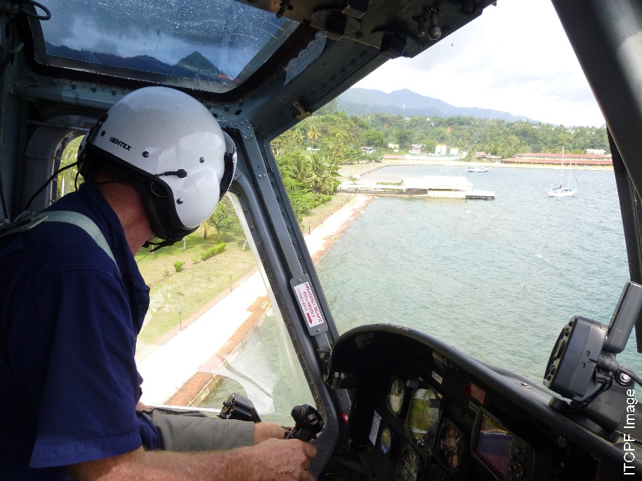
Aerial Survey
Aerial reconnaissance using observations, photos, and video.
Provides an overall picture of the situation in a short amount of time.
Needs further “on the ground” assessment.
Source: ITOPF
CGPRT(W) : Ensuring Clean Seas and Coasts in Western Region ……

Slide 6
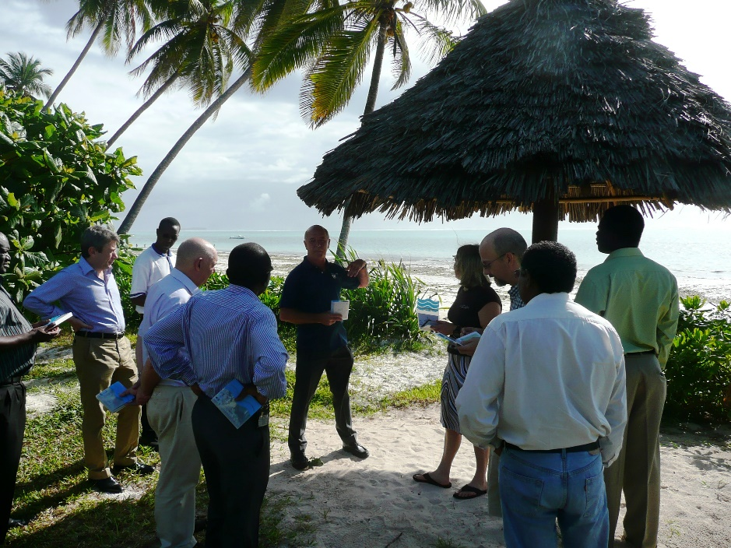
Ground Survey
Provides more detailed information
May require a number of teams with differing skills
Can be done in addition to continuing aerial surveys
Source: OSRL
CGPRT(W) : Ensuring Clean Seas and Coasts in Western Region ……

Slide 7
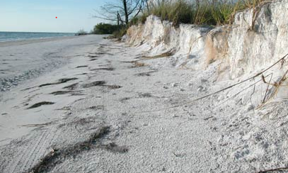
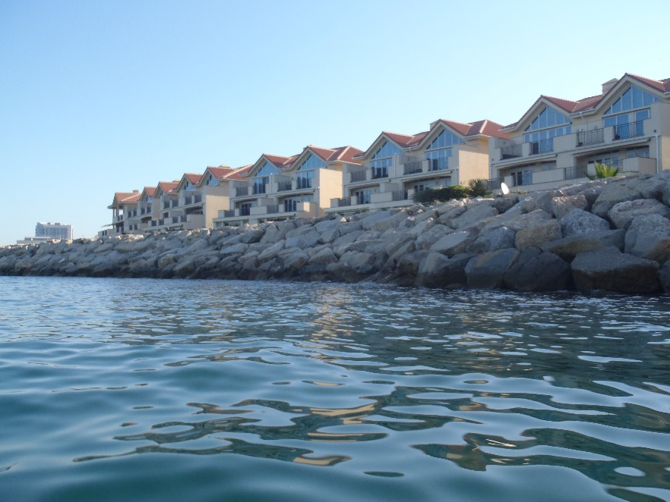
Describe Coastal Conditions
Overview of characteristics of affected shore including load-bearing capacity.
Operational activities take place in the backshore zone and this needs to be characterized.
Source : OSRL
Source: OSRL
CGPRT(W) : Ensuring Clean Seas and Coasts in Western Region ……

Slide 8
Describe Oiling Conditions
Surface oil distribution
Surface oil thickness
Oil character
Subsurface oil
CGPRT(W) : Ensuring Clean Seas and Coasts in Western Region ……

Slide 9
SCAT Team
  Made up of representative stakeholders
      Governments, landowner, shipowner, spill response expert, beach supervisor/master.
Kept to a manageable size (three to five team members).
Team members consult on oiling conditions and proposed clean-up techniques for each segment and gain consensus to ensure an accurate unbiased view.
CGPRT(W) : Ensuring Clean Seas and Coasts in Western Region ……

Slide 10
Operations’ Role in SCAT
The role of Operations in SCAT is to:
provide clean-up expertise
guide and agree recommendations on technically feasible clean-up strategies including:
  equipment and logistical requirements/limitations
  treatment methods
  reporting format and frequency
CGPRT(W) : Ensuring Clean Seas and Coasts in Western Region ……

Slide 11
Conclusion
SCAT teams are the “eyes” of Incident Command providing real-time data on oiling conditions.
SCAT teams require Operations input.
SCAT teams require logistical support.
CGPRT(W) : Ensuring Clean Seas and Coasts in Western Region ……

Slide 12
Any questions?
CGPRT(W) : Ensuring Clean Seas and Coasts in Western Region ……

